Slide 1
L6: Group 9 Project Final Pitch
Thomas Simmons, Callam Mutton, Quwaine Dantes - McPherson

Slide 2
Brief Overview
Fiero and a zen like focus.
wont be considered another platformer clone/ generic platformer.
Challenges the player
Immerses them into the game
Gameplay rather than the narrative.
C

Slide 3
Target Audience/Demographic
12 to 25 year old male and female casual gamers
BigFish Blog
Flurry Games
Mobile Metrix Games
TS

Slide 4
Research
We looked into some 2d side-scroller games to find a theme that didn’t occur regularly
Most characters where human related
Looked at current rabbit based games:
Rayman Raving Rabbit
Lugaru
Hell Yeah Wrath of the dead rabbit

Slide 5
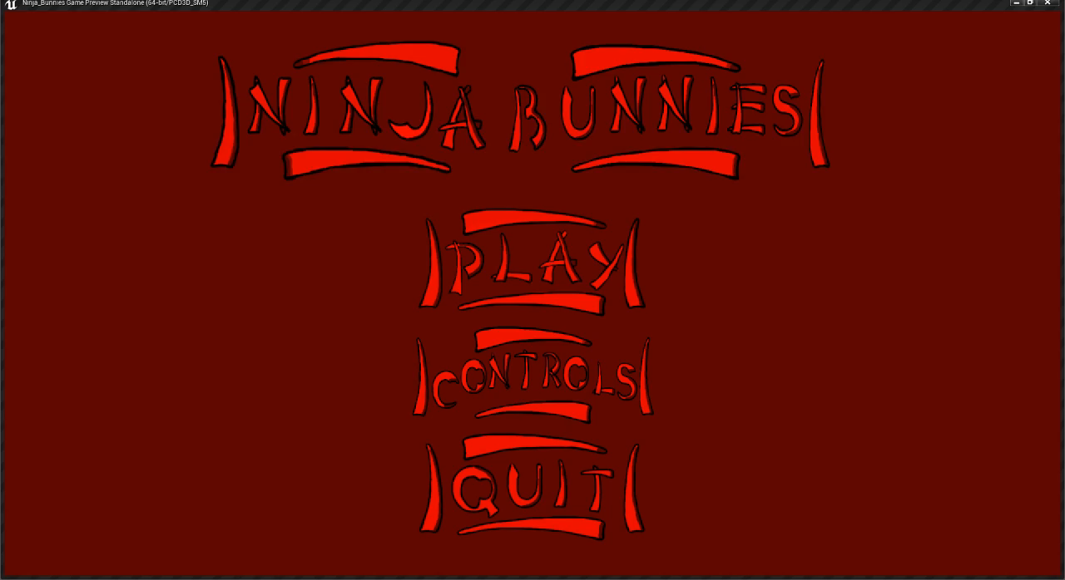
Final Gameplay Video

Slide 6
Overview of our game: Ninja Bunnies
Logline
Ninja Bunnies, end the spider shoguns reign and free your villager rabbits
Player controls a ninja rabbit
Find paths to either avoid or destroy enemies
Collect keys to open sectors of the map
Defeat shogun and release rabbit villagers
C

Slide 7
Player Reward
Collect ninja stars
Contribute to the players final score
Players reaching checkpoints
Rewards for killing/ avoiding enemies
CM

Slide 8
How did our game meet our brief
Reaching the goal of player empathy through using animal protagonists
Using empathy we where targeting anger and joy
Trying to immerse the player using a narrative
Instructions and gameplay that are easy to understand
It’s a simple 2D snack game with simple core, positive and negative game loops
D

Slide 9
Feedback from gameplay playtesting
Main Menu didn’t look nice and didn’t relate well
The platforms where to big
The gameplay camera should be zoomed out
Shogun spider movement looked rigid
There was no way for the player to know what to do.
C

Slide 10
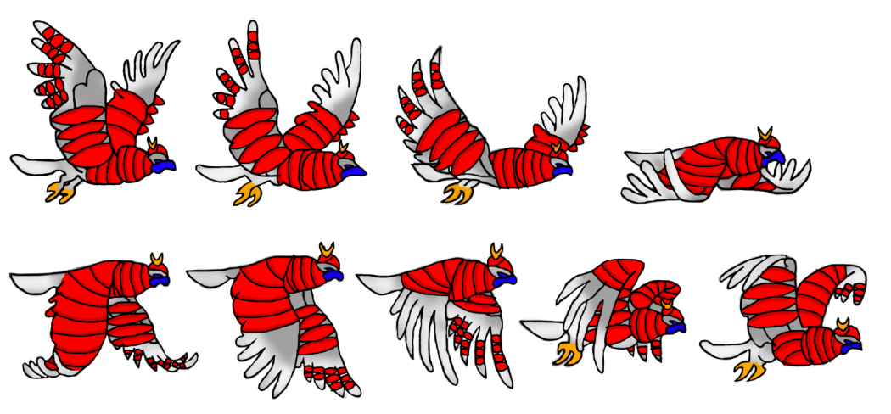
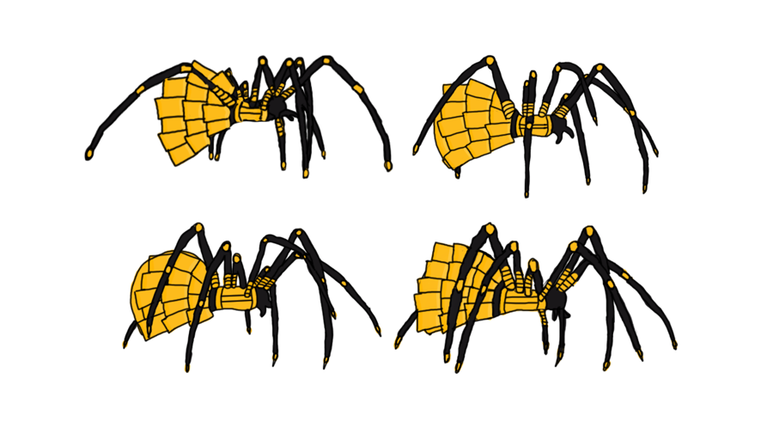
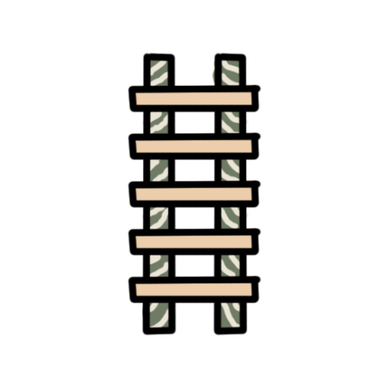
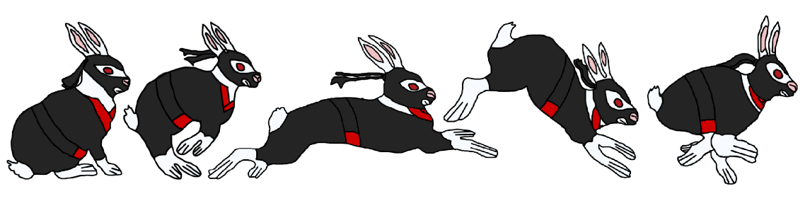






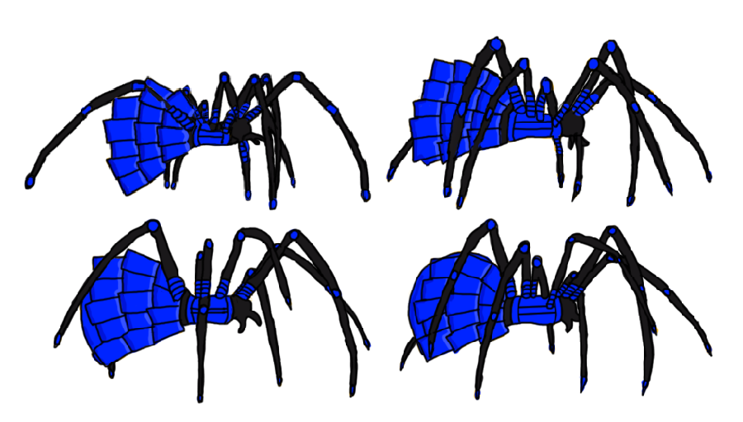


Artwork
T

Slide 11
Final Features
Simple 2D snack game
Unlocking levels as the player progresses
Checkpoints available
Basic interactive menu screen
Smooth animated characters (Rabbit and Bird)
Q

Slide 12
Future Development
SFX
Cut scenes
Dialogue
Final Boss with boss stage attack patterns
Animations for spider and rabbit completed
T

Slide 13
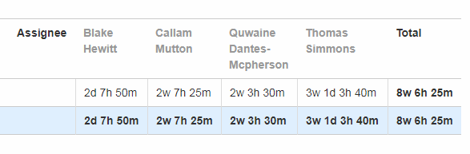
JIRA Hours Completed
Callam: 87hrs 25m
Quwaine: 83hrs 30m
Thomas: 131hrs 25m
Total: 302hrs 10m
Q

Slide 14
Any Questions

